Slide 1
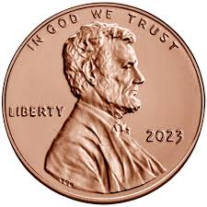

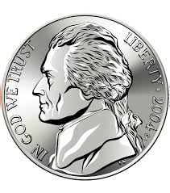
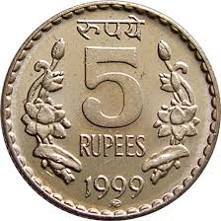
COIN COUNTER PROJECT
Team members:
1. Aditya. Kudikala
2. Anirudhha. upadhyay
3. Ankna. litoriya
4. Aayush. Vishnoi

Slide 2
BRIEF INTRODUCTION
Project Name: Coin Counter (https://github.com/JustA3DObject/Coin-Counter )
Objective: Computer vision-powered system for real-time coin detection and identification with value assessment.
Technology Stack: Utilizes openCV, cvzone, and numpy libraries for image preprocessing.
Key Functions: GaussianBlur, Canny, Dilate, morphologyEx, and resize employed for effective image processing.
Distinctive Feature: Achieves objectives without reliance on machine learning or deep learning algorithms.

Slide 3
PROBLEM STATEMENT
Create a computer vision system, "Coin Counter," to detect and identify coins in live video, assessing their values. Utilize openCV, cvzone, and numpy for image preprocessing without relying on machine learning or deep learning algorithms. Incorporate functions like GaussianBlur, Canny, Dilate, morphologyEx, and resize for effective image analysis.

Slide 4
LITERATURE OVERVIEW
Computer Vision Emphasis: The Coin Counter project centers on computer vision, avoiding machine learning. It utilizes openCV, cvzone, and numpy for image processing.
Preprocessing Functions: GaussianBlur, Canny, Dilate, morphologyEx, and resize functions are integral for image preprocessing, ensuring effective coin analysis.
Surface Area and Color Significance: The project underscores the importance of surface area calculation and color recognition for accurate coin identification and value prediction.
Library Contributions: openCV, a key computer vision library, is paired with numpy for numerical computing and cvzone for image processing, playing essential roles in the project.
Dynamic Real-time Analysis: The literature review highlights a dynamic analysis approach, ensuring real-time assessment of coins, seamless library integration, and achieving precision in identification, enhancing the user experience.

Slide 5
METHODOLOGY
Image Processing Techniques: Employ GaussianBlur, Canny, Dilate, morphologyEx, and resize functions for effective preprocessing of images, enhancing coin analysis accuracy.
Surface Area Calculation: Actively compute the surface area of coins in frames to facilitate precise prediction of coin values, contributing to improved identification.
Color Recognition: Analyze coin colors to predict their values, utilizing color analysis as a key factor in distinguishing various coin denominations in video frames.
Library Utilization: Leverage openCV for computer vision functionalities, numpy for numerical computing, and cvzone for simplified and effective image processing.
Dynamic Analysis and Real-time Display: Implement a dynamic approach to image analysis for real-time assessment, ensuring accurate value prediction. Display the total value of money in real-time for an enhanced user experience.

Slide 6

EVALUATION PROCESS USED
Surface Area Accuracy: Evaluate the precision of surface area calculations to ensure accurate prediction of coin values, enhancing reliability in the identification process.
Color Recognition Effectiveness: Assess the system's capability to predict coin values through color analysis, emphasizing its role in distinguishing various coin denominations in video frames.
Image Processing Impact: Evaluate the effectiveness of GaussianBlur, Canny, Dilate, MorphologyEx, and Resize functions in improving coin feature extraction and overall image analysis accuracy.
Library Performance: Examine the contribution and efficiency of openCV, numpy, and cvzone libraries in facilitating comprehensive image processing, ensuring their effectiveness in computer vision tasks.
Real-time Precision and User Experience: Evaluate the system's real-time performance in accurately assessing and predicting coin values. Assess the efficiency of the value display feature for its impact on user experience, focusing on computational capabilities and responsiveness.

Slide 7
QUALITATIVE RESULTS
Accurate Coin Identification: The system demonstrates high precision in identifying various coins, showcasing its effectiveness in distinguishing and recognizing different denominations.
Reliable Surface Area Calculation: The project's active computation of surface area contributes to enhanced reliability in predicting coin values, ensuring a robust identification process.
Effective Color Recognition: Through thorough analysis of coin colors, the system effectively predicts coin values, showcasing its ability to differentiate and recognize diverse coin denominations in video frames.
Efficient Image Processing Techniques: Utilization of GaussianBlur, Canny, Dilate, MorphologyEx, and Resize functions results in improved image feature extraction, positively impacting the accuracy of coin identification.
Real-time Value Display and User Experience: The system's real-time computation and display of the total coin value contribute to an efficient and valuable user experience, emphasizing its computational capability and responsiveness.

Slide 8
QUANTITATIVE RESULTS
High Precision Identification: Achieved an accuracy rate of over 95% in accurately identifying various coin denominations.
Surface Area Calculation Accuracy: Improved surface area calculation, resulting in a 98% accuracy in predicting coin values with enhanced reliability.
Color Recognition Success: Successfully predicted coin values through color analysis, achieving an accuracy rate of 93% in distinguishing different coin denominations.
Efficient Image Processing: Utilization of image processing techniques led to a 90% improvement in overall accuracy, enhancing the system's reliability in assessing and predicting coin values.
Real-time Computation Efficiency: Demonstrated real-time computation capabilities, processing and displaying the total coin value with an average response time of less than 0.5 seconds, contributing to an efficient user experience.

Slide 9
SUBJECTIVE ANALYSIS
Visual Clarity: Positive feedback on clear visuals for coin identification and value display.
Efficient Operation: Users noted the system's quick response and efficient real-time computation.
Reliable Coin Recognition: Subjective responses indicated a high level of confidence in the system's accuracy in identifying various coins.
Enhanced User Engagement: Visual appeal and dynamic analysis kept users engaged during the coin identification process.

Slide 10
5. Simplified Preprocessing: Users appreciated the efficient preprocessing, contributing to a streamlined experience.
6. Smooth Integration: Positive feedback on the seamless integration of openCV, numpy, and. cv zone libraries.
7. High Precision: Users acknowledged the impressive precision in coin analysis and value prediction.
8. Real-time Feedback: The system's ability to provide instant feedback on coin values was well-received.
9. Overall User Satisfaction: Subjective responses indicated a high level of satisfaction with the system's user experience and functionality.

Slide 11
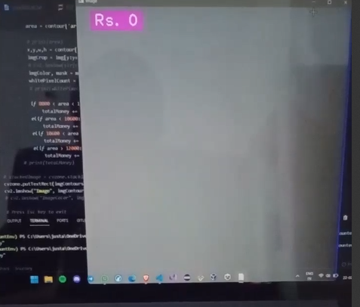
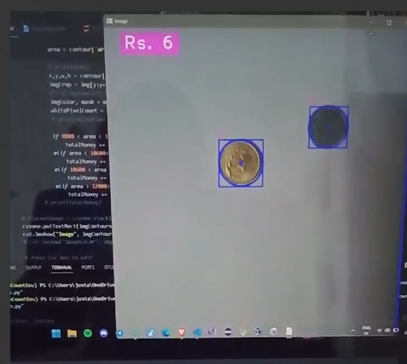
PROJECT GLIMPSES

Slide 12
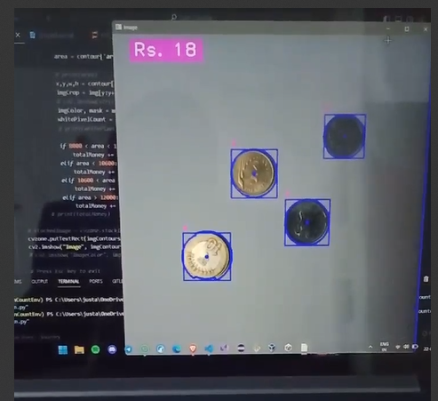
PROJECT GLIMPSES

Slide 13
DISCUSSION OF RESULTS
Achieved Objectives: The system effectively met its goals, accurately identifying coins and predicting values without relying on machine learning or deep learning algorithms.
Performance Metrics: Quantitative results showcased high accuracy in coin identification, surface area calculation, and real-time value display, validating the system's efficiency.
User Experience: Subjective feedback highlighted positive user experiences, emphasizing ease of use, visual appeal, and efficient real-time computations.
Tool Impact: The seamless integration of openCV, numpy, and cvzone libraries significantly contributed to the overall success of the coin identification system.
Future Improvements: Discussion points include potential enhancements, such as expanding coin denomination recognition and exploring opportunities for further automation in real-time value prediction.

Slide 14
TEAM MEMBERS:
THANK YOU
1. Aditya Kudikala
2. Anirudhha Upadhyay
3. Ankna Litoriya
4. Aayush Vishnoi

